Slide 1

ESOFT Education.
sathusan@1secmail.com

Slide 2
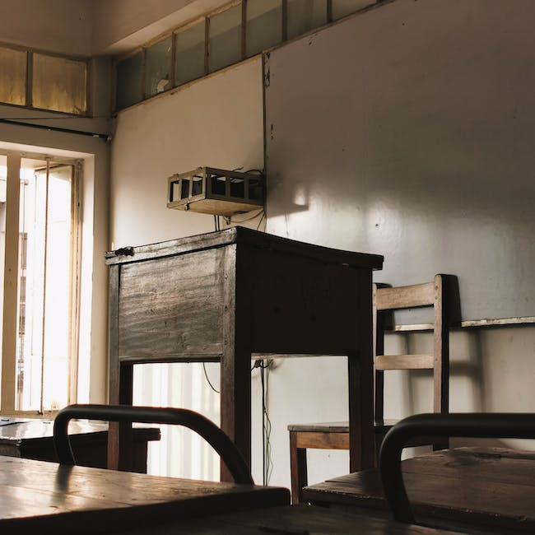
Content
ESOFT Metro Campus
Established Institution
Academic Qualifications
Dr Dayan Rajapakse

Slide 3
ESOFT Metro Campus
ESOFT Metro Campus previously known as ESOFT Computer Studies is a private sector educational institute situated in Colombo Sri Lanka

Slide 4

Established Institution
Founded in the year 1991 the college offers a wide range of academic and professional qualifications in computing business management engineering hospitality and English fields

Slide 5
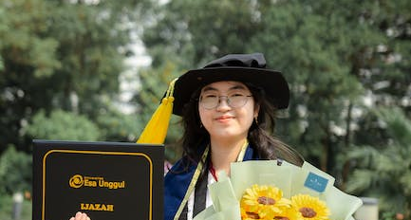
Academic Qualifications
The far-reaching college has currently over 20 branches across the country

Slide 6
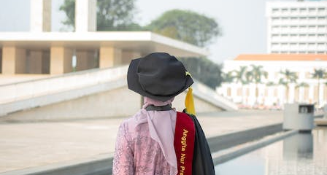
Dr Dayan Rajapakse
Leading the organization is Dr Dayan Rajapakse as the Chairman and CEO
[Established in 1991 ESOFT Metro Campus is a premier private sector educational institution located in Colombo

Slide 10
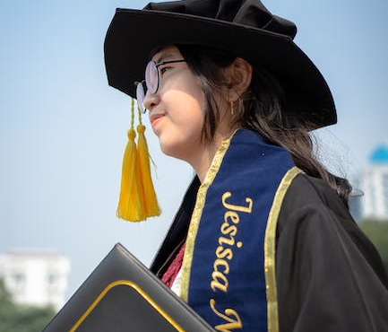
THANK YOU !
2023-10-19

